Slide 1
<HTML>
.CSS
My Hi-Tea Tech
29 September

Slide 2
What’s HTML and CSS?

Slide 3
<HTML>
.CSS
Style
Content

Slide 4
HTML
It’s all about the tags

Slide 6
Element

Slide 7
Element
Attribute

Slide 8
Content
Element
Attribute

Slide 9
HTML
An example

Slide 10
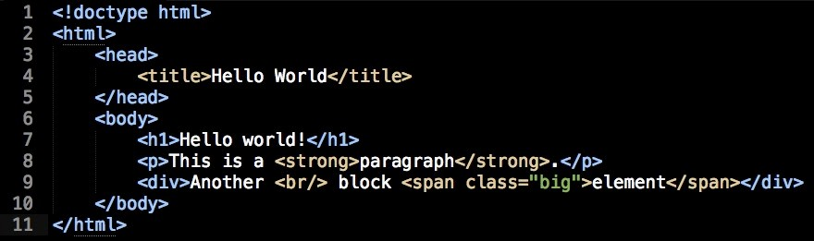

Slide 11
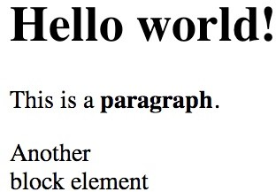

Slide 12
Structure first
What’s inside an HTML document?

Slide 13
<HTML>
The container

Slide 14
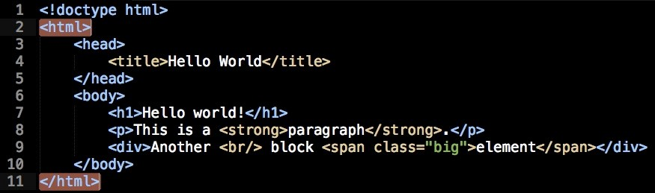

Slide 15
<HEAD>
The setup

Slide 16
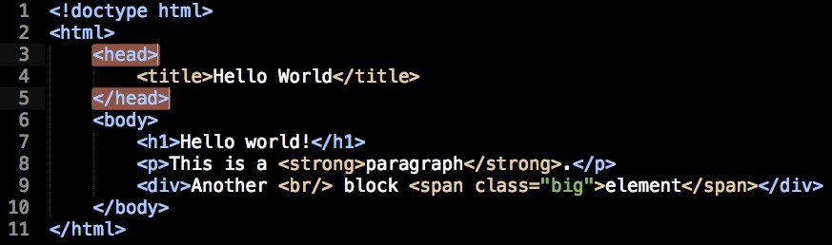

Slide 17
<BODY>
The content

Slide 18
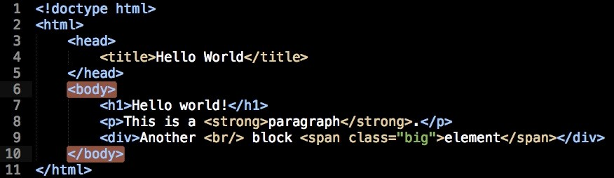

Slide 19
Writing the content

Slide 20
Block or Inline

Slide 22
Block
Inline

Slide 23
Block
Create a new line and occupy full width

Slide 24
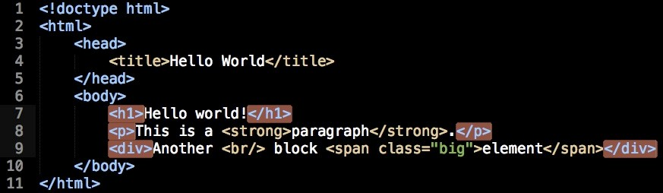

Slide 25
Inline
Keep the flow of the document

Slide 26
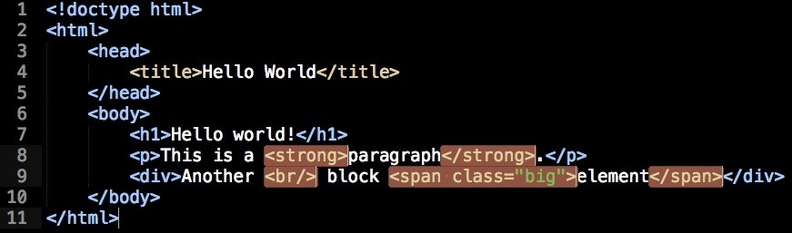

Slide 27
Usually work in pairs

Slide 29
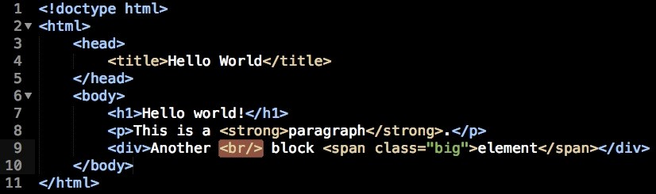

Slide 30
Most Important Elements
You’ll use these 90% of the time

Slide 31
<DIV>
The all-mighty block element

Slide 32
<SPAN>
The inline <div>

Slide 33
Paragraph is for text
<P>

Slide 34
<H1>
Headings from H1 to H6

Slide 35
<A>
Link to other pages or sections

Slide 36
But use them wisely

Slide 37
HTML is semantic

Slide 38
Tags have meanings

Slide 39
Don’t suﬀer from divitis

Slide 40
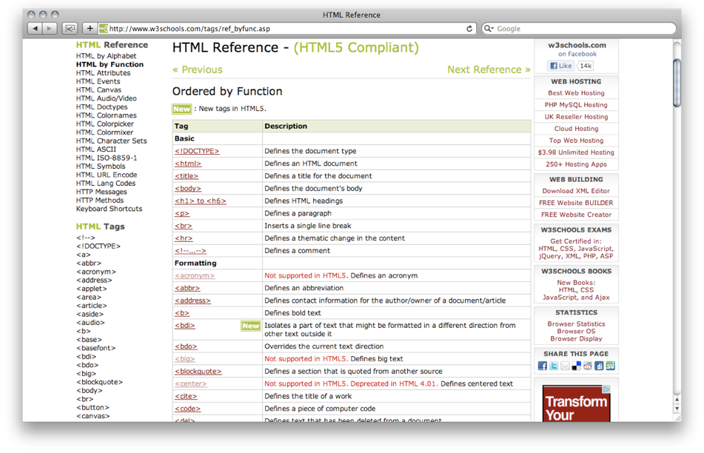

Slide 41
Start with the structure

Slide 42
Hello HTML5!

Slide 43
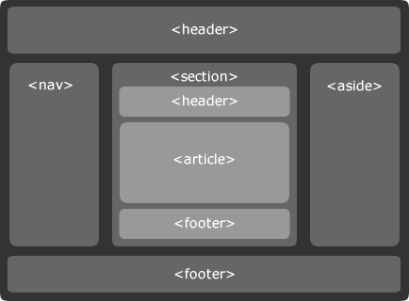

Slide 44
<HEADER>
Header for a document or section

Slide 45
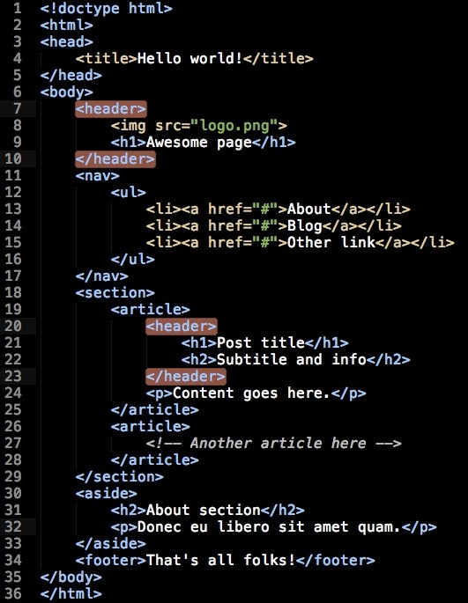

Slide 46
<NAV>
The new navigation menu

Slide 47
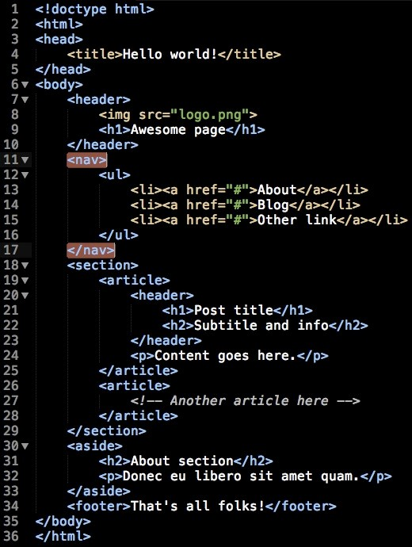

Slide 48
<SECTION>
The new <div>

Slide 49
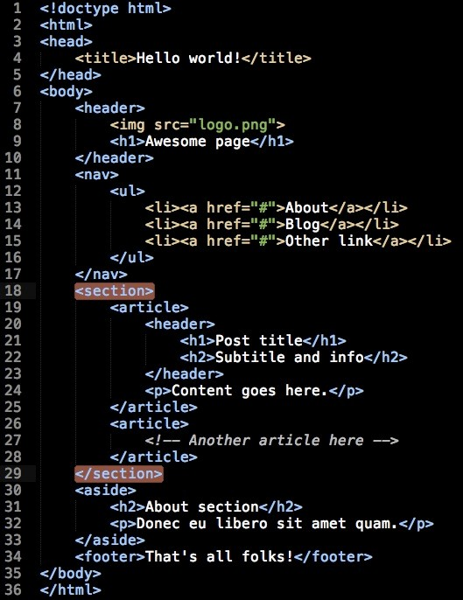

Slide 50
<ARTICLE>
Blog posts, news stories, comments

Slide 51
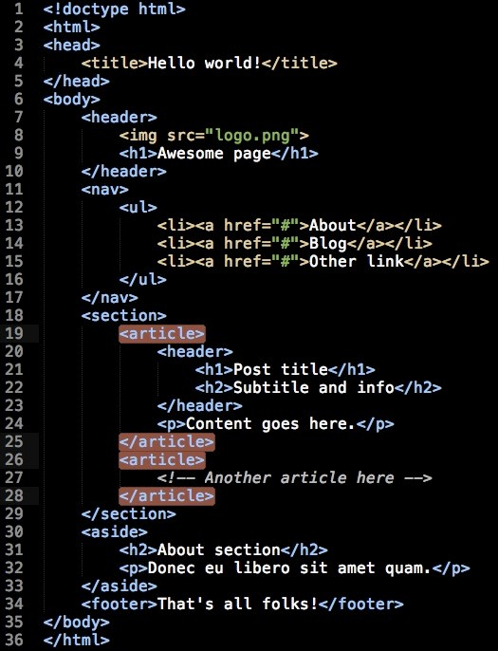

Slide 52
<ASIDE>
Related, but not really important content

Slide 53
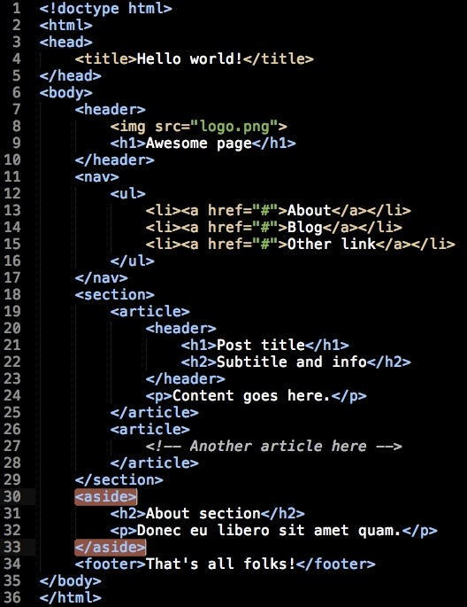

Slide 54
<FOOTER>
Footer for a document or section

Slide 55
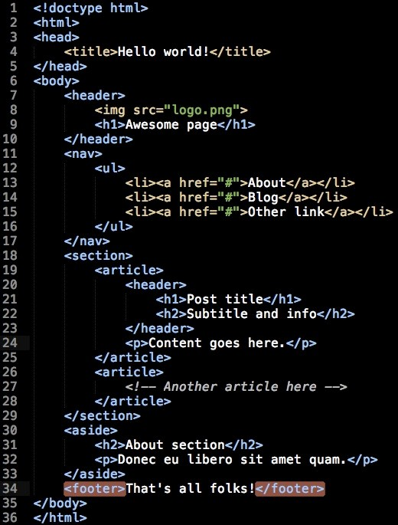

Slide 56
A real example

Slide 57
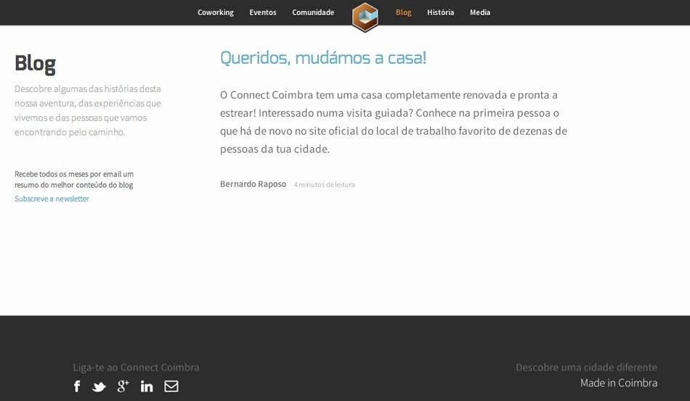

Slide 58
<header>

Slide 59
<nav>

Slide 60
<section>

Slide 61
<article>

Slide 62
<footer>

Slide 63
HTML resources

Slide 65
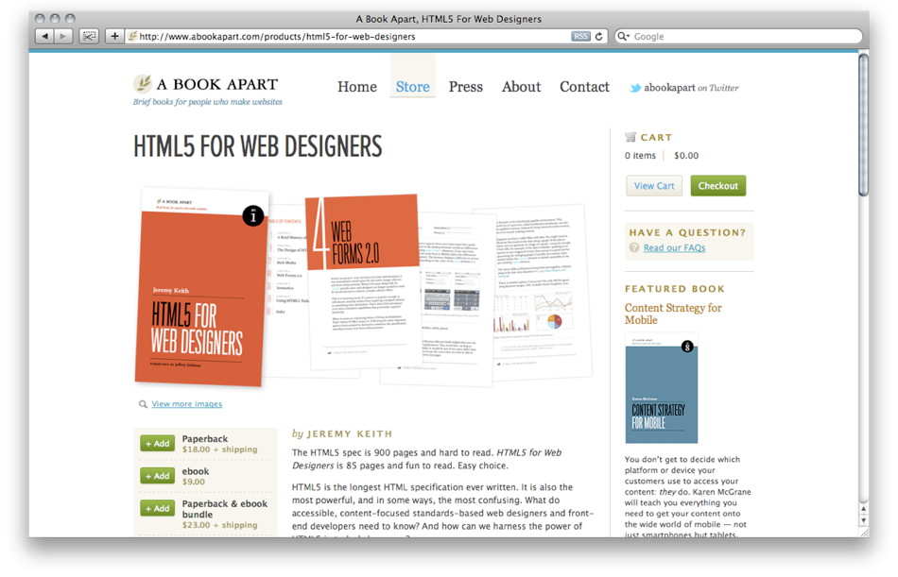

Slide 66
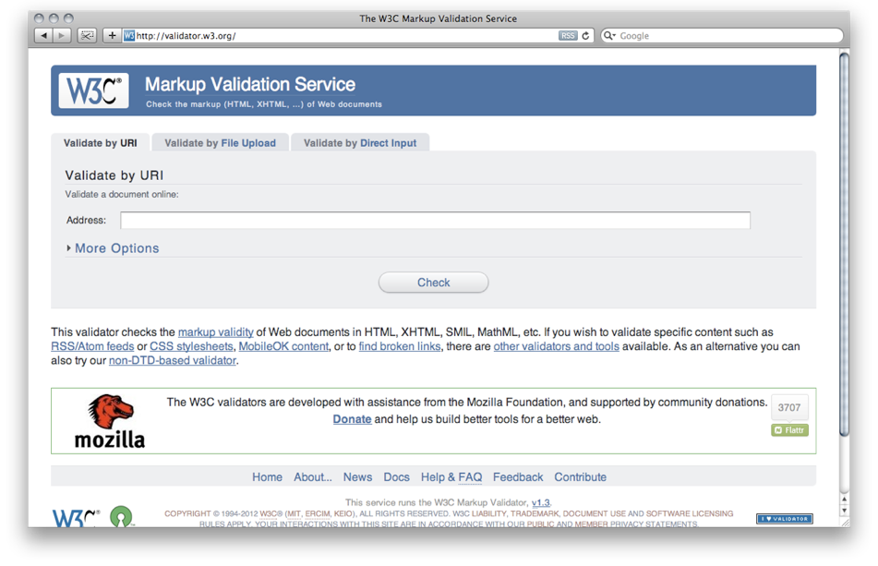

Slide 67
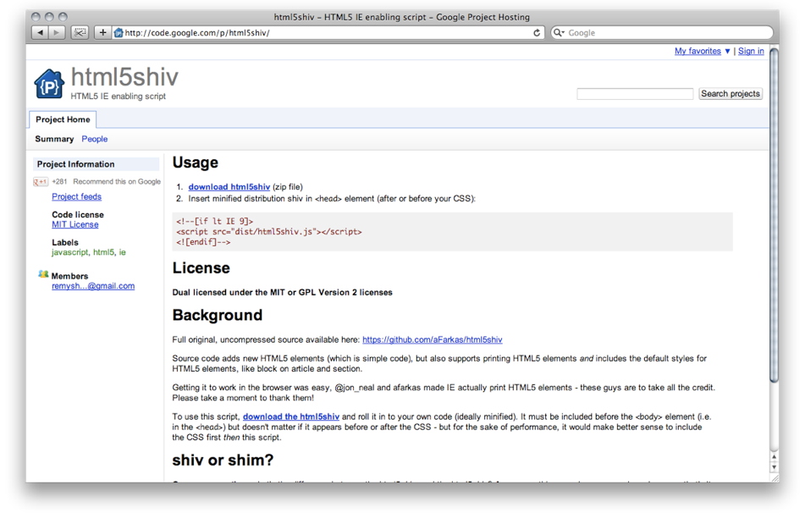

Slide 68
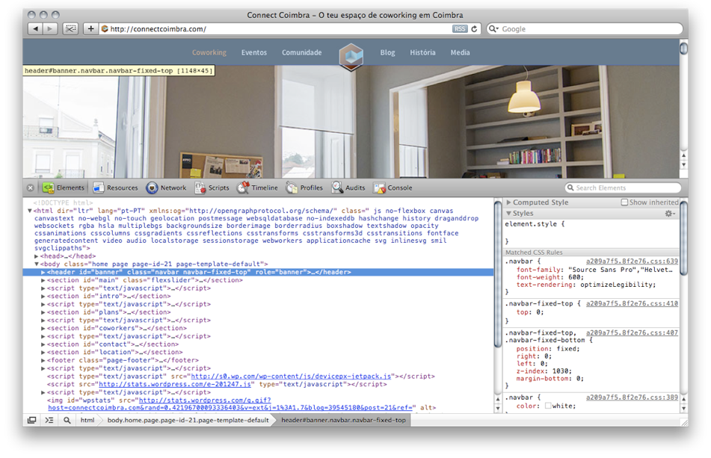

Slide 69
Let’s start styling!

Slide 70
Add the CSS to the page

Slide 71
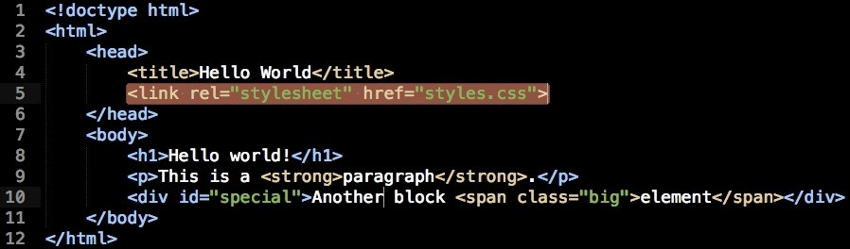

Slide 72
Selectors
Select element to style

Slide 73
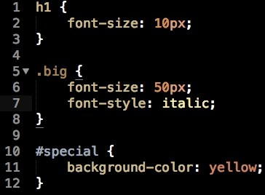

Slide 74
Tag
Class ID

Slide 75
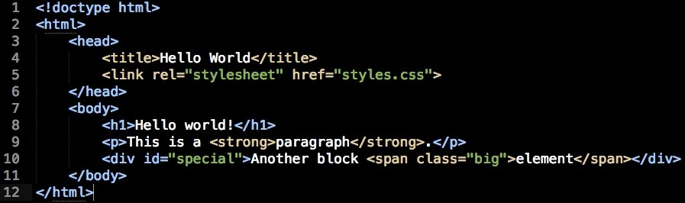
Tag
Class
ID

Slide 76
You can be very specific

Slide 77
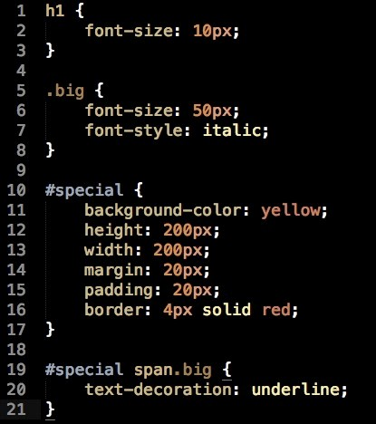

Slide 78
Be careful with the space

Slide 79
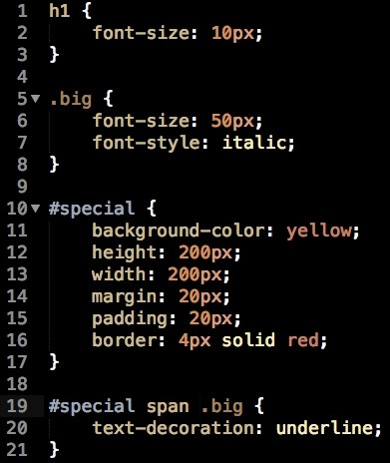

Slide 80
Properties
What do you want to change?

Slide 82
Values
Determine the behaviour of the property

Slide 84
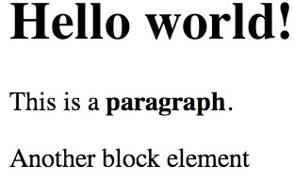

Slide 85
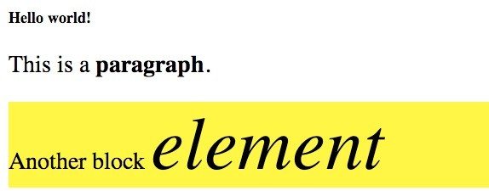

Slide 86
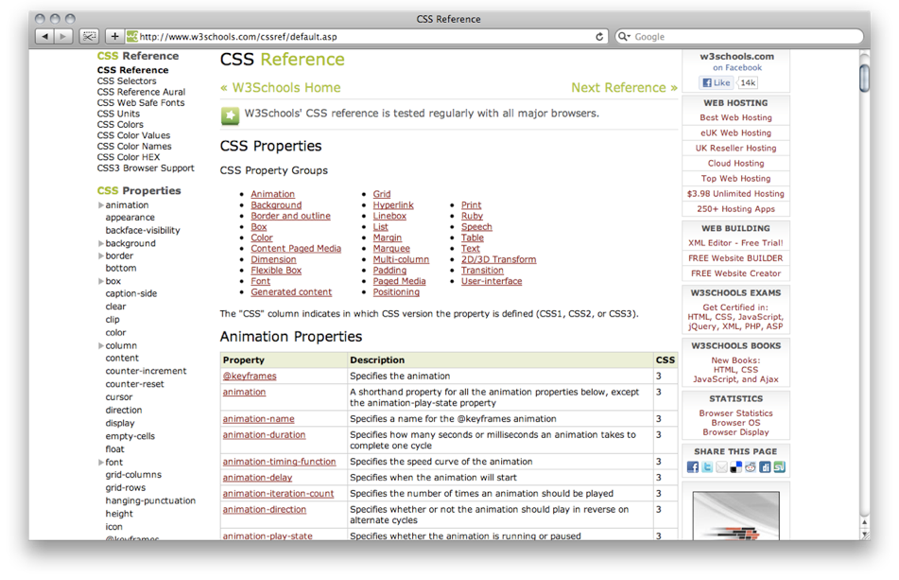

Slide 87
Browsers have custom styling

Slide 88
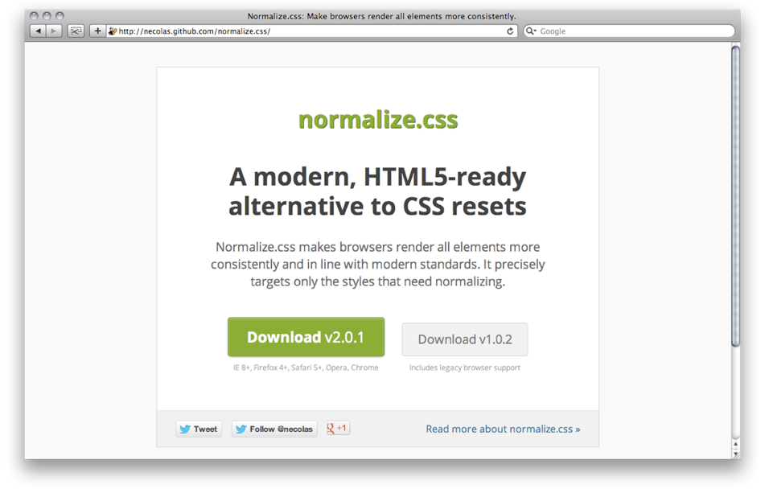

Slide 89
And custom properties

Slide 90
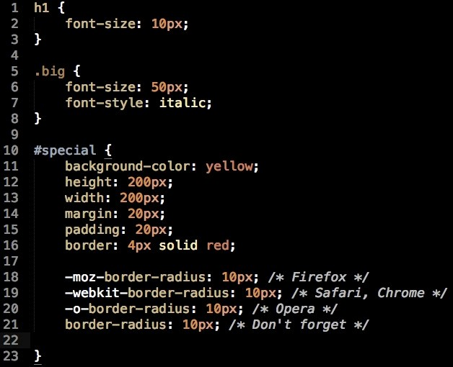

Slide 91
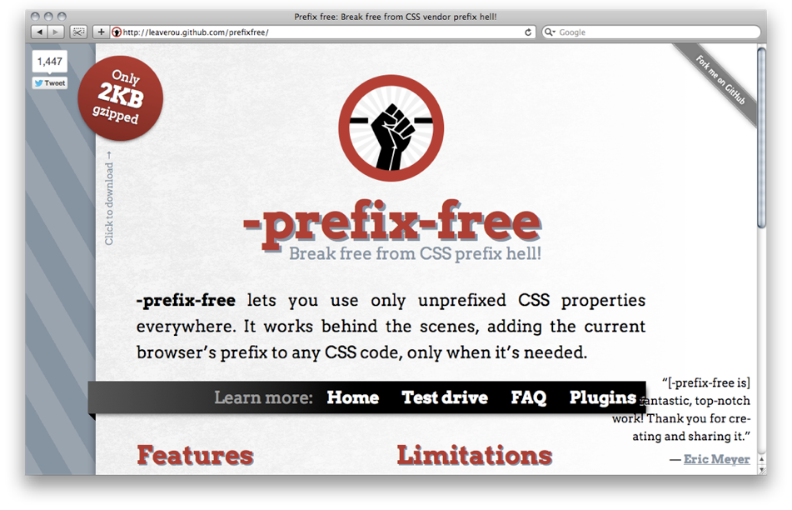

Slide 92
The box-model

Slide 93
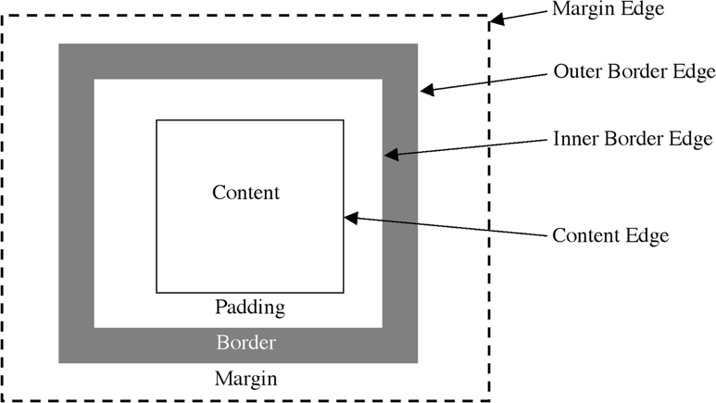

Slide 94
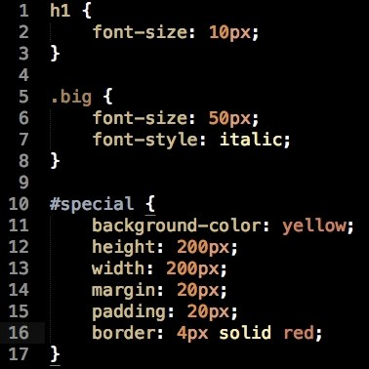

Slide 96
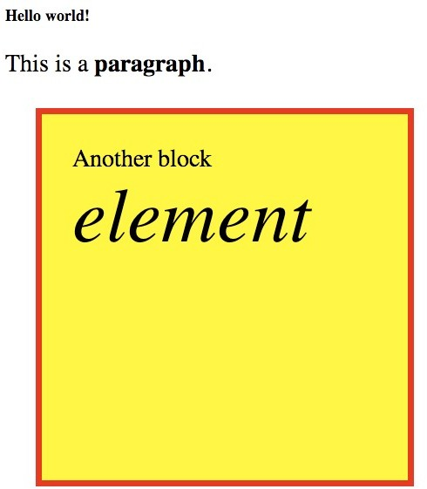

Slide 97
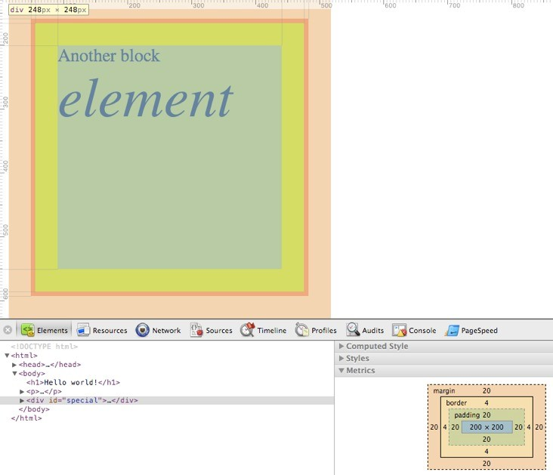

Slide 98
CSS can change everything

Slide 99
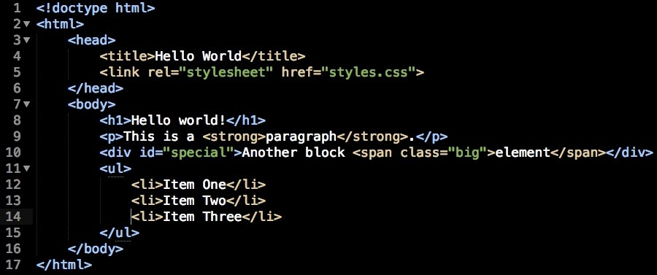

Slide 100
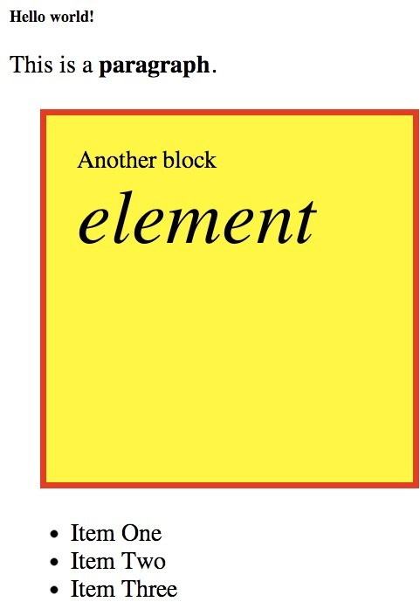

Slide 101
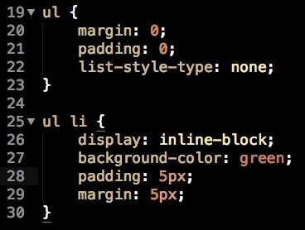

Slide 102
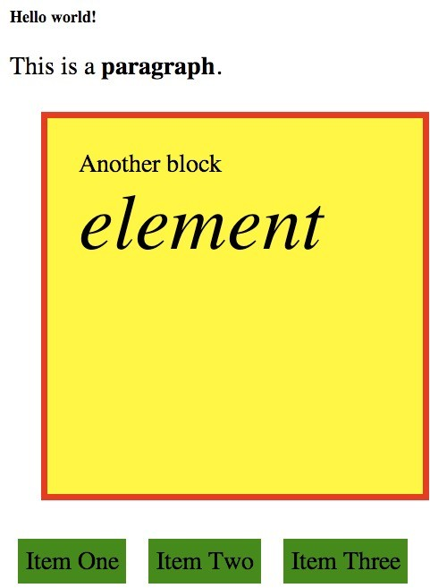

Slide 103
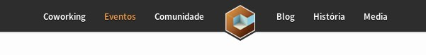

Slide 104
CSS3 is awesome

Slide 105
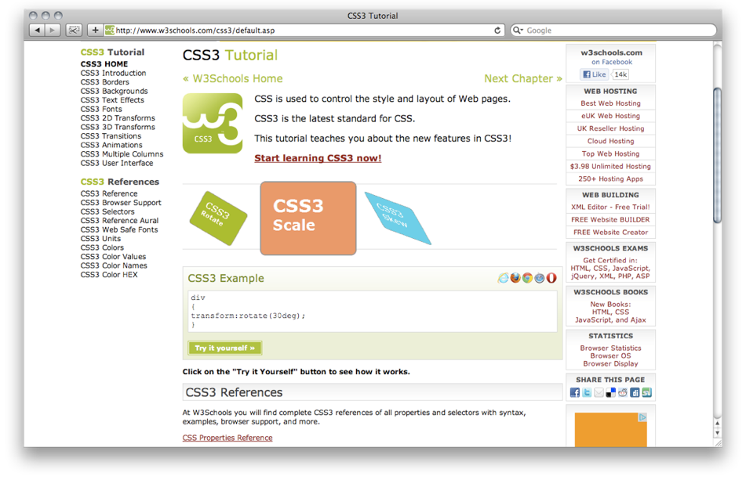

Slide 106
But Keep It Simple!

Slide 107
You don’t even need to work

Slide 108
There are tons of CSS frameworks

Slide 109
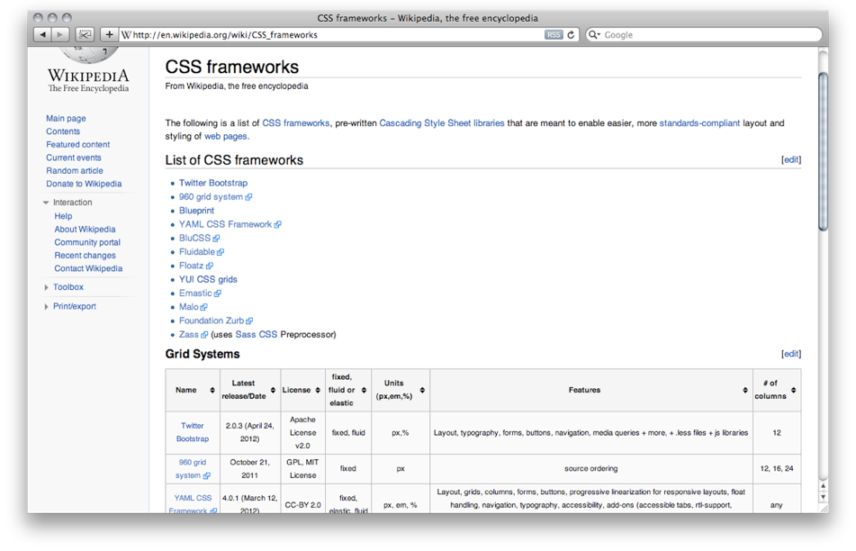

Slide 110
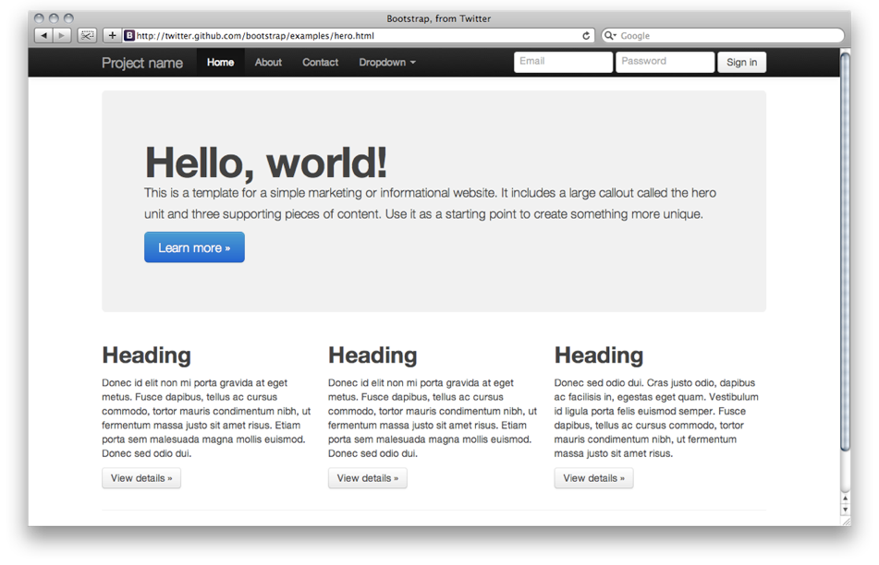

Slide 111
Keep learning

Slide 112
Questions?

Slide 113
Thank you!
@hiteatech

